Slide 1
Existing/Future Programs and Grid Stakeholder Group
Q1 2018 Meeting
February 23, 2018 (9AM – 1:30PM)

Slide 2
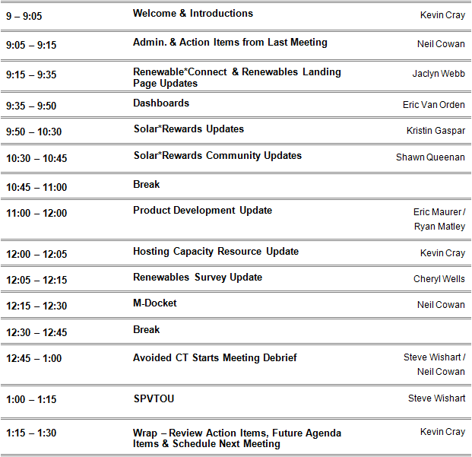
AGENDA
Existing/Future Programs and Grid Stakeholder Group

Slide 3
Admin. & Action Items from Last Meetings
Existing/Future Programs and Grid Stakeholder Group
Admin.
  General Comments and Questions?
  Next Meeting – May 18
Action Items:
  SPVTOU Load Factor Reduction
  TOU Participation and Battery Installations
  PLEXOS Modeling
3

Slide 4
Renewable*Connect
February Update
COLORADO

Slide 5
Program Recap and 2018 Pricing
Existing/Future Programs and Grid Stakeholder Group
50 MW additional solar
Capacity based subscriptions
Flexible terms: monthly, 5-year, or 10-year
RECs retired on behalf of customer
Pricing
  Charge: price schedule known up-front and locked-in for subscription term
  Credit: avoided energy + avoided capacity, credit fluctuates based on natural gas prices
Price / kWh | 10 Year | 5 Year | Month to Month
Charge | $0.041 | $0.042 | $0.044
Credit | $0.041 | $0.041 | $0.041
2018 Net Price | $0.000 | $0.001 | $0.004*
*Doesn’t reflect table calculation due to rounding
Notes:
More details on website

Slide 6

Program Timeline
Existing/Future Programs and Grid Stakeholder Group
Customer webinars
  Communities/Cities, March 13
  C&I Customers, April 11
  Invitations and logistics in development
Program Launch
  March 26 (tentative): Phase I, R and C class
  May 21 (tentative): Phase II, all other customers
System in service and billing begins
  December
6

Slide 7

Enrollment Process
Existing/Future Programs and Grid Stakeholder Group
Phase I
R and C Class customers only
March 26, open for 8 weeks
Enrollment through My Account
Phase II
All remaining customers
May 21, open for limited time
Enrollment through XcelEnergy.com
7
Notes:
- 8 weeks, everyone gets what they asked for as long as it follows program rules
- Contracts must be signed within 7 business days of receipt of contract or application is cancelled

Slide 8
Robust Marketing
Existing/Future Programs and Grid Stakeholder Group
Comm-unities
Radio
Email
Media Release
Digital
Ads
Bill Onsert
Social
Media
Website
Managed
Accounts
Cities

Slide 9

Renewable Experience Update
Existing/Future Programs and Grid Stakeholder Group
Advisor tool on CO renewable landing page
Link to renewable program comparison chart from R*C program page
Presentation of other program options from individual program pages
9

Slide 10
2016 Settlement Agreement Program Capacity
Existing/Future Programs and Grid Stakeholder Group
Solar*Rewards Annual Capacity (MW) | 2017 | 2018 | 2019 | Total
Small Option A | 24 | 24 33 | 24 | 123
Small Option B | 9 | 18 | 24
Medium | 24 | 24 | 24 | 72
Large | 6 | 10 | 14 | 30
Total Program Capacity | 63 | 76 | 86 | 225
*Net Metering Only | Applications exceeded Solar*Rewards in 2017
Solar*Rewards Community Capacity (MW) | 2017 | 2018 | 2019 | Total
Minimum | 15 | 15 30 | 15 | 45
Maximum | 30 | 35 65 | 40 | 105
100% Low-income | 4 | 4 | 4 | 12
Combined Maximum | 34 | 39 69 | 44 | 117

Slide 11
Solar*Rewards & Net Metering Dashboards
Existing/Future Programs and Grid Stakeholder Group
Private On-site Solar Applications Received
(2017 Year End Cumulative)
(kW)
Notes:
Xcel Energy handles almost 100 MW of private on-site solar applications, including standard offer incentives programs, net metering only, and competitive solicitations.

Slide 12
Solar*Rewards & Net Metering Dashboards
Existing/Future Programs and Grid Stakeholder Group
Small Solar*Rewards
Monthly Applications (2017)
Small Net Metering
Monthly Applications (2017)
Notes:
Solar*Rewards participation dropped in 2017. But, customer participation continues. Each offering leads to average system size of about 6 kW (roughly 8,500 kWh/year). Count and capacity are relatively interchangeable.
Net Metering averages 5.7 kW
Solar*Rewards average 6.1 kW
PV Watts- 6 kW at 10%, 180% south = 8,630 - http://pvwatts.nrel.gov/pvwatts.php

Slide 13
Solar*Rewards & Net Metering Dashboards
Existing/Future Programs and Grid Stakeholder Group
Small Solar*Rewards & Net Metering Monthly Applications (2017)
(kW)
Solar*Rewards Program provides up to 24 MW of annual REC incentives, which is available for up to 2 MW per month.
13
Notes:
Capacity for on-site applications for projects below 25 kW exceeded the main Small Solar*Rewards capacity for 2017 of 24 MW.
We saw the drop in Small Solar*Rewards participation last spring. But, the program has stayed steady around 1 MW per month since.
Net Metering Only has officially become a part of the mix, to the tune of 27 MW worth of applications in 2017.
So, we’ve been facilitating the installation of much more than 24 MW of small on-site solar, when including the roughly 16.5 MW from Small Solar*Rewards.
Overall, small solar looks to be doing quite well.
Small Solar*Rewards gets the half-penny incentives and the participating customer pays for the production meter. Net Metering only gets the retail rate incentive. But, the production meter is socialized.
At $1.50 per month for the meter, the break even for cost is roughly a 2.5 kW system producing 3,600 kWh per year. Are there any non-financial reasons to go the Net Metering Only path?

Slide 14
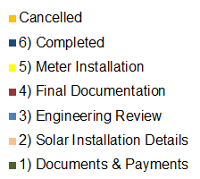
Solar*Rewards & Net Metering Dashboards
Existing/Future Programs and Grid Stakeholder Group
Small Solar*Rewards Stage Status (Snapshot in Time)
Small Net Metering Only Stage Status (Snapshot in Time)
Notes:
Roughly 50% of Solar*Rewards and Net Metering applications created in 2017 were completed by EOY. Roughly 21% of Solar*Rewards applications* were canceled, while about 9% of net metering only were cancelled.
*The cancellation % estimate removes the 675 kW that were cancelled almost immediately because of a delay in closing the program opening.
The lower NEM cancellation rate might be because there is less reason to cancel. In part because they don’t pay a deposit. (But they do pay a study fee). They will be cancelled after 12 months.

Slide 15
Solar*Rewards & Net Metering Dashboards
Existing/Future Programs and Grid Stakeholder Group
Medium Solar*Rewards
Quarterly Applications 2017
Medium Solar*Rewards
Rollover Reasons 2017
(Qty)
(kW)
(kW)
(Qty)
Notes:
We tried our best, and then some, to subscribe 24 MW of Medium capacity
190 kW per project is average, 160 is median, 25.01 min, 500 max
Program opening duration
Q1 - 0:43
Q2 - 4:04
Q3 - 6:17
Q4 - 53:59:16
Q4b - 0:00:06
Q1 2018 – 48 hours
Concerned about unviable projects

Slide 16
Solar*Rewards & Net Metering Dashboards
Existing/Future Programs and Grid Stakeholder Group
Medium Solar*Rewards Stage Status (Snapshot in Time)
(kW)
16
Notes:
Relatively large amount of cancellations, not just from rollover/duplicates.
I’ll let Kristin talk about the Large program. We did have a very competitive bid from 2017 and look forward to the 2018 process.

Slide 17

Solar*Rewards Community Project Status
Solar*Rewards Community
Project Status by Capacity
Solar*Rewards Community
Project Status by Project Count
Notes:
107 MW total
78 in Development
29 completed
77 MW total
54 in Development
23 completed

Slide 18
Solar*Rewards
Existing/Future Programs and Grid Stakeholder Group
Medium Program New Duplicate Rule
  Q1 had three duplicate applications from three different installers.
  1st warning given. No changes to their user accounts at this time.
  2nd warning reduces installer to one user license.
    during Medium program openings only
  No oddities/bug identified in system after IT review
  All duplicates were entered more than 1 minute apart - 1 minute rule working
    Users can check if application was accepted in user portal
  Program is staying open longer.
 | Program Open Duration HRs/Min/Sec
2017 Q1 | 0:0:43
2017 Q2 | 0:4:04
2017 Q3 | 0:6:17
2017 Q4 | 53:59:16
2018 Q1 | 48:04:33
Notes:
It’s only a warning. Not action is taken at this point.
Even if they do it again, they would still be able to put in multiple applications in one round if the program stays open for more than 60 seconds, with one login.
Salesforce search functionality does index each record as soon as it is created which will allow users to search those records later (something like how google give search results based on keywords).
Salesforce has no functionality that would delay a record from showing up in a user’s portal once it has been created.
However, it is still possible users may not be able to search for a record that was created recently if the user navigated away from the application as soon as it was created and tried searching for it immediately and nothing showed up in their search results.
Other possibility is that when they hit the back button on the browser and keep hitting the submit button till they see an application creation.
These are user errors rather than a bug.

Slide 19
Solar*Rewards
Existing/Future Programs and Grid Stakeholder Group
Medium Program New Duplicate Rule
  We know mistakes happen. But, there are repeat duplicate offenders.
  Have to reserve judgement and be fair across the board.
  Slow down and make entries count.
  We are open to holding trainings before the next program opening to review best practices.
    1:1 with installer
    Xcel hosted training (in-person or webinar)
    COSEIA member call
Notes:
We want to see viable solar projects to move forward in a timely and efficient manner. – installers/developers control this.
43% attrition of projects from the Q1 2017 opening
Reason: “Customer does not want to proceed”
Why are customers deciding not to move forward even after the REC secured?
Historically, more than 24 MW of Medium applications have been opened. We can’t control the ones that are removed. Individual solar developers can.
COSEIA and the stakeholder group accepted the proposal (or at least didn’t object when we aired it in two different meetings)
Yes. Mistakes happen. But, there is also deliberate duplications. We have to reserve judgement and be fair across the board.
If you don’t enter duplicates, this won’t be an issue. Slow down and make your entries count.

Slide 20
Solar*Rewards
Existing/Future Programs and Grid Stakeholder Group
Small Solar*Rewards Option B – Peak Demand Pricing
  2017 capacity of 9 MW went unsubscribed.
  Unsubscribed capacity is rolled into Small Option A and evenly distributed over 2018 on a monthly basis.
  Thus, 2018 Small Option A available capacity is 2.75 MW per month.
  Small Option A continues to not sell out.

Slide 21
Solar*Rewards
Existing/Future Programs and Grid Stakeholder Group
2018 Large Solar*Rewards RFP
  10 MW available – could go to a single customer
  Price is primary differentiator and selection criteria
  Added language about option to releasing bid prices
  Meet with PUC Staff to review recommendations for winner(s)
Proposals due
4/25/18
System operational date
12/7/19 (18 months)
RFP Release date
3/12/18
(open for 45 days)
Staff Review of Bids
5/29/18
Pre-bid meeting/call
tentative 3/20/18
Targeted award announcement date
6/8/18 (review 45 days)

Slide 22


New! Solar*Rewards and NEM Webpages
Existing/Future Programs and Grid Stakeholder Group
Notes:
Our solar program pages received a facelift with a new look and feel.
Providing a step by step process that is customers centric.
New links to Is Solar Right For You page utilizing Google’s Project Sunroof too, and a consolidated FAQ page for new & existing customers & installers/developers

Slide 23

New! Participant Information Webpage
Existing/Future Programs and Grid Stakeholder Group
Notes:
The initial welcome email received by the customer when a SR application is started on their behalf will direct them to this page where they can view new customer FAQs, the application process, and questions about moving

Slide 24
Battery Interconnection Update
Existing/Future Programs and Grid Stakeholder Group
Continue to review battery design packages in greater detail prior to application submittal so that subsequent submissions of that design should have fast approval.
  Reviewed six different design combinations so far
  Host continual training with engineers on battery review procedures
  Just over 10% Completed and over 60% in Final Documentation
  Reach out to CObattery@xcelenergy.com to ask questions or submit a battery review package: attestation, manuals, one-line
Product | Solar Installation Details | Documents & Payments | Engineering Review | Final Documentation | Meter Installation | Completed | Total
New Solar + Battery: | 9 | 16 | 19 | 149 | 3 | 29 | 225
Standalone/Retrofit Battery: | 4 | 10 | 6 | 17 |  | 1 | 38
Grand Total: | 13 | 26 | 25 | 166 | 3 | 30 | 263

Slide 25
Solar*Rewards Community
Existing/Future Programs and Grid Stakeholder Group
Subscriber participation uptick in 2017
  Program participation grew by nearly 25%
  Average subscriber received a bill credit of $168.87

Slide 26
Solar*Rewards Community
Existing/Future Programs and Grid Stakeholder Group
26

Slide 27
Solar*Rewards Community
Existing/Future Programs and Grid Stakeholder Group
2018 Q1 Forecast
  6MW planned to be interconnected by mid March
  >1/3rd of 2016 RFP projects are in study or have an IA already
  80% of 2016 Standard Offer projects have IAs signed or issued
    Many targeting Q2 and Q3 interconnections
  Program expected to double total interconnections 2018
  Release 2017 RFP, 2018 Low Income RFP, 2016 Standard Offer and other associated offerings
27

Slide 28
Low-income SR*C RFP - Bid Review Screens
Existing/Future Programs and Grid Stakeholder Group
Eligibility Screening
  Was bid submitted before the RFP closed?
  Did it included required bid fee?
  Were all bid forms completed?
  Does proposed system qualify as a community solar garden?
  Is proposed interconnection within 18 months of award?
  Will the proposed system use approved technologies?
  Did the bid have a REC price based on production or up-front payment?
28

Slide 29
Low-income SR*C RFP: Scoring Criteria
Existing/Future Programs and Grid Stakeholder Group
Non-Economic Factors
  Energy & REC production
  Developer experience
  Additional commitments to low-income subscribers may include, but not limited to:
    Percentage Bill Reduction
    Job Training
    EE Measures
  Construction Schedule
  Geographic Location
Economic Analysis
  Net present value comparison
  Potential Bill Credit costs evaluated based on subscriber commitments & estimated production
29

Slide 30
Low-income SR*C RFP: Review Process
Existing/Future Programs and Grid Stakeholder Group
Net present value comparison utilized to rank the costs of CSGs on a comparable basis.
Projects tiered:
  1st Tier: all projects less than 2 X of the lowest bid (i.e. $10 X 2 = $20)
  2nd Tier: all projects within 2-4 X of the lowest bid (>$20 to $40)
  3rd Tier: all projects within 4-6 X of the lowest bid (>$40 to $60)
  4th Tier: all projects within 6-9 X of the lowest bid (>$60 to $90)
30

Slide 31
Low-income SR*C RFP: Detailed Review
Existing/Future Programs and Grid Stakeholder Group
Projects within first tier are assigned scores based on additional commitments.
Non-Economic factors are reviewed based on:
  Viability
  Enforceability
  Persistence
  Participation Criteria
    Customer Rate Class Mix
    End customer benefits received
    Energy Efficiency Audit Requirements
  ‘Community’ qualification
  Clarifying questions are used to determine the feasibility of each non-economic commitment to understand any additional information that might be needed
31

Slide 32
Low-income SR*C RFP: Awarding Process
Existing/Future Programs and Grid Stakeholder Group
Present table mix of all bids showing their tier, additional commitments, and any other relevant information with ranking and justification to Xcel Energy leadership.
Review with PUC Staff.
Send notices to RFP winners outlining post-bid requirements and portal access.
Inform non-winning bids.
32

Slide 33
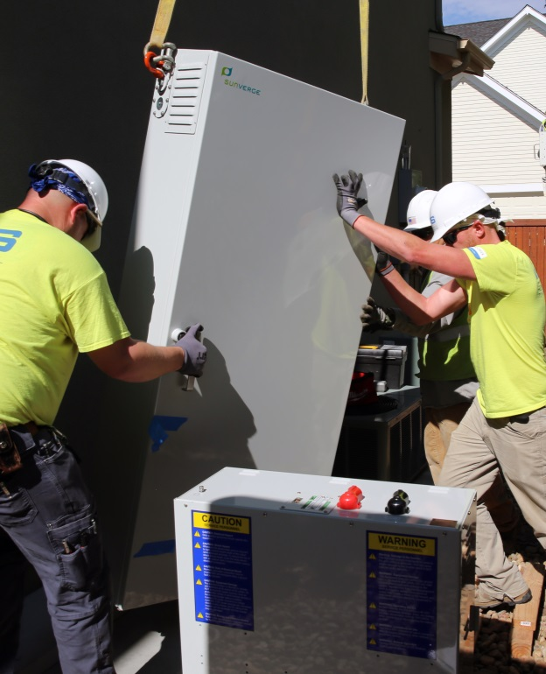
The state of customer-sited batteries
Existing/Future Programs and Grid Stakeholder Group
Stapleton Pilot
Number of Residential Battery Applications, (2017-2018)*
Installed (30)
In interconnection process (231)
*Data current as of Friday, February 16
33

Slide 34
Using customer-sited batteries today and in the future
Existing/Future Programs and Grid Stakeholder Group
Primary use shared btw grid and customer
Integrated, optimized with other technology
Primary use for backup
Other options:
-Commercial DR
-Rate management
-Voluntary solar time shifting
Grid examples:
-Demand response
-Renewable integration
-Distribution deferral
-Ancillary services
Customer examples:
-Rate management
-Back-up
Backup only
Interconnection options
Pre-2017
TODAY
FUTURE
34

Slide 35


Taking another step forward—battery demand response project
Existing/Future Programs and Grid Stakeholder Group
Signal
Output
Project Basics
Engage with customers already making investment
Test battery response to DR signal
35

Slide 36



Objectives of the project
Existing/Future Programs and Grid Stakeholder Group
Availability and performance
Response to participation options, usage
Integration into DRMS
36

Slide 37
Value streams/functions we will explore
Existing/Future Programs and Grid Stakeholder Group
Traditional Demand Response
(use for system contingency and capacity events)
Economic Demand Response
(utility calls on resource to reduce total system costs)
Local Distribution Support
(under consideration)
37

Slide 38
Customer participation levels
Existing/Future Programs and Grid Stakeholder Group
Customer Type 1 (solar+storage)
Interconnection allows export (2B, 3A, 3B)
Full battery capacity possible
Customer Type 2
(stand-alone or solar+storage)
Interconnection does not allow export (1B, 1C, 2C)
Estimate average customer load
Issues to Consider
Effect of charging restrictions on capacity (customer type 1 and 2)
Effect of load on capacity (customer type 2)
38

Slide 39
Event duration, frequency, and response speed
Existing/Future Programs and Grid Stakeholder Group
4 Hour Events
Near-daily Dispatch
10-Minute Response
39

Slide 40
Vendor eligibility
Existing/Future Programs and Grid Stakeholder Group
Limited to a small number of storage vendors to manage costs
Factors we consider include (but may not be limited to):
  Deployment
  Utility experience
  Integrated API with DRMS provider
  Battery control capabilities
40

Slide 41
Next steps*
Existing/Future Programs and Grid Stakeholder Group
Rebate levels
Size of program
Measurement and verification plan
Filing approach and timing
Interconnection interactions
*Not exhaustive
41

Slide 42
Hosting Capacity Resource
Existing/Future Programs and Grid Stakeholder Group
All feeders have been modeled in Synergi
Preparing models for analysis in the EPRI Drive tool
The Minimum Day Time Load Study Table has been updated and posted to the SRC Developer webpage
  https://www.xcelenergy.com/staticfiles/xe-responsive/Working%20With%20Us/Renewable%20Developers/CO-Minimum-Daytime-Load-Study-Report.pdf
The Hosting Capacity Heat Map has been posted for our MN service territory
  https://www.xcelenergy.com/working_with_us/how_to_interconnect/hosting_capacity_map

Slide 43
Methodology: Online Survey
Colorado Residential Customers
Launch survey | 01/23/2018
Close survey | 02/09/2018
Number of email invitations | 14,522
Number of completes | 1,343
Response rate | 9.2%
Incentive | No
 | # | %
Windsource® | 1,070 | 68%
Not Sure | 226 | 14%
Solar*Rewards® | 121 | 8%
Solar*Rewards® Community® | 73 | 5%
Net Metering® | 79 | 5%
TOTAL | 1,569 | 100%
43

Slide 44
The Majority of Respondents are Windsource Customers
N=1,569
N=925
Q. Please select the Xcel Energy renewable program that you are currently participating in:
Q. How long ago did you enroll?
44

Slide 45
Top Reason for Choosing Renewable
Program: Help the Environment
Top 4
N=2,775
Multiple Responses
Q. Which of the following reasons best describe why you chose to participate in a renewable energy program? Please select your top three.
45

Slide 46
#1 Environmental Concern: Reducing the
Impacts of Climate Change
Top 3
Q. Please rank your environmental concerns in order of importance.
46

Slide 47
Climate Change is a Very Important
Consideration When Choosing Renewable Programs
N=925
Q. To what degree did climate change weight into your renewable choice decision?
47

Slide 48
Sixty-five Percent of Respondents Did Not
Consider Other Renewable Programs or Did Not Recall
N=860
Multiple Responses
Q. When evaluating your renewable options, did you consider any of Xcel Energy’s other Renewable Programs? Please select all that apply.
48

Slide 49
Satisfaction with Value for Price Paid is High
N=924
Q. From a monetary /environmental consideration, how satisfied are you with the value you receive from the price paid?
49

Slide 50

Miscellaneous Proceeding
Existing/Future Programs and Grid Stakeholder Group
Comment Period:
  Initial Comments – January 31
  Reply Comments – ~February 14
Process Forward:
Timing?

Slide 51
Continuing PLEXOS Solar Analysis
Existing/Future Programs and Grid Stakeholder Group
Additional PLEXOS modeling investigating marginal and solar avoided costs, with additional analysis on the impact of solar on gas unit starts.
Methodology
  New PLEXOS simulations for 2020 and 2026 (before and after Colorado Energy Plan).
  Baseline simulation + incremental solar additions
    +50 MW
    +250 MW
    +500 MW
51

Slide 52
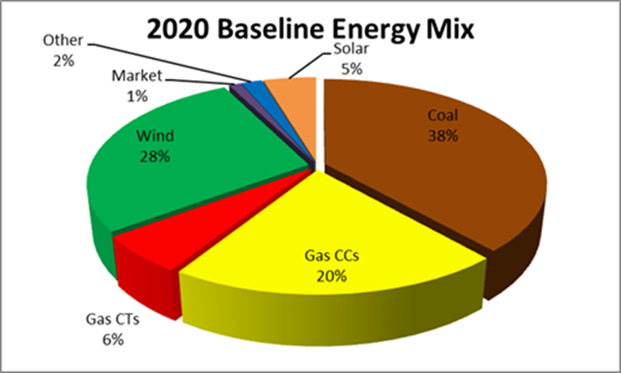
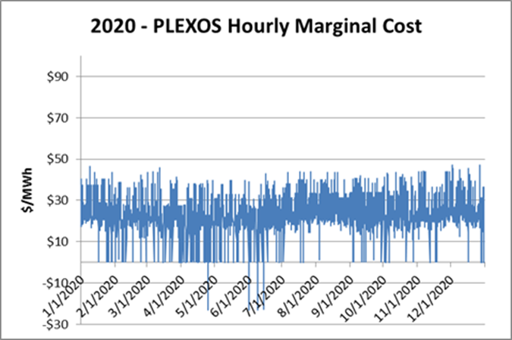
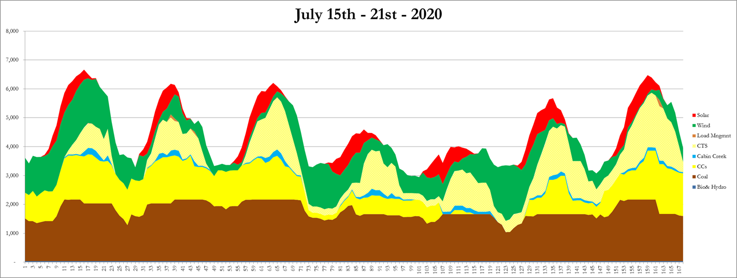
Continuing PLEXOS Solar Analysis
Existing/Future Programs and Grid Stakeholder Group
Last time – Reviewed PLEXOS Inputs & Baseline Results
52

Slide 53
Continuing PLEXOS Solar Analysis
Existing/Future Programs and Grid Stakeholder Group
This time 2020 & 2026 results
  2 Methods
    Solar weighted marginal cost
      Hourly PLEXOS marginal cost weighted by representative solar patter
      Hourly penalties removed
      QF methodology
      Solar patterns – fixed panel vs 1 axis tracking
    Avoided solar costs
      Compare baseline PLEXOS total costs to other scenarios with incremental solar additions (50MW, 250MW, 500MW)
      Avoided fuel, VOM, purchased energy, starts, wind curtailment
      Does not address capacity credits or avoided T&D issues
53

Slide 54
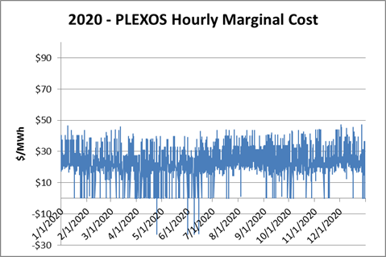
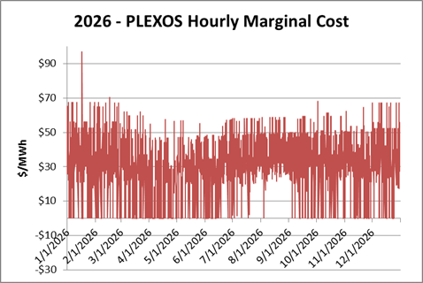
Solar Marginal Cost Analysis
Existing/Future Programs and Grid Stakeholder Group
QF methodology is based on solar weighted marginal costs
PLEXOS reports marginal costs for each hour of the year based on the variable cost for the next MWh of production.
54

Slide 55
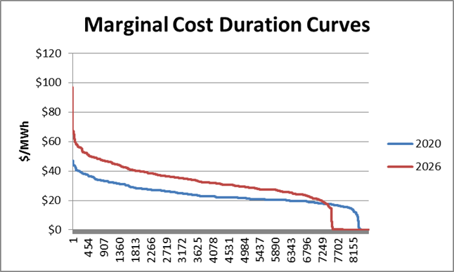
Solar Marginal Cost Analysis
Existing/Future Programs and Grid Stakeholder Group
55

Slide 56
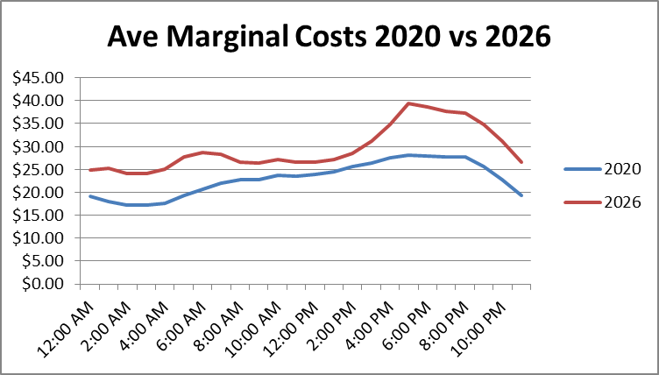
Solar Marginal Cost Analysis
Existing/Future Programs and Grid Stakeholder Group
56

Slide 57
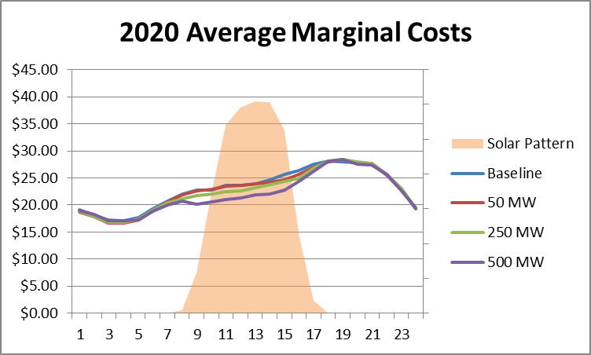
Solar Marginal Cost Analysis
Existing/Future Programs and Grid Stakeholder Group
57

Slide 58
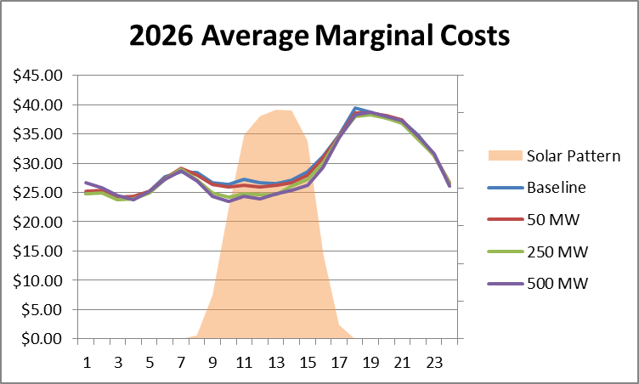
Solar Marginal Cost Analysis
Existing/Future Programs and Grid Stakeholder Group
58

Slide 59
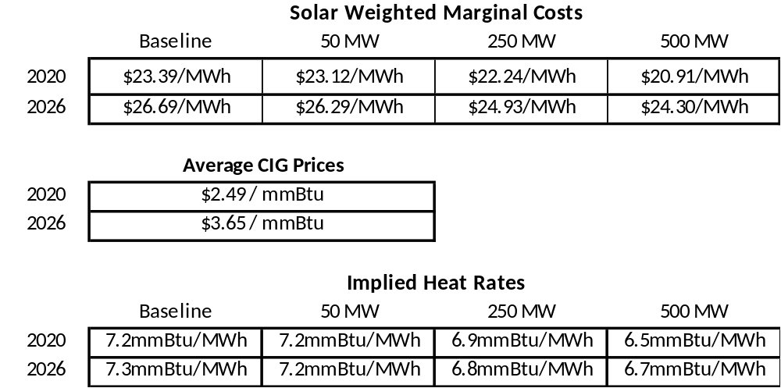
Solar Marginal Cost Analysis
Existing/Future Programs and Grid Stakeholder Group
59

Slide 60
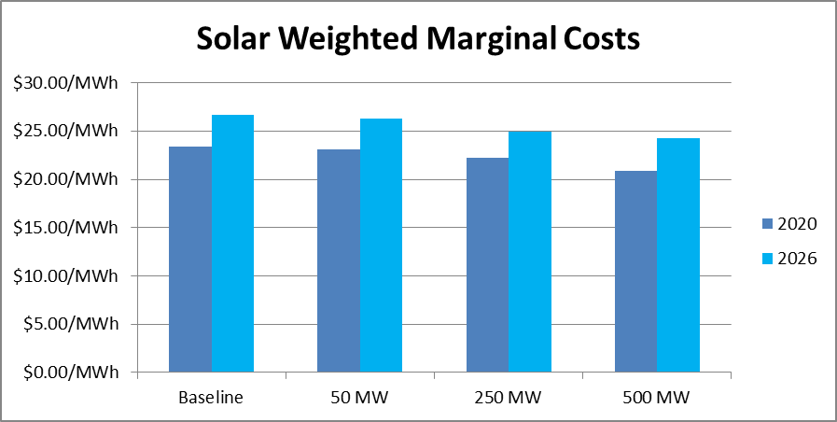
Solar Marginal Cost Analysis
Existing/Future Programs and Grid Stakeholder Group

Slide 61
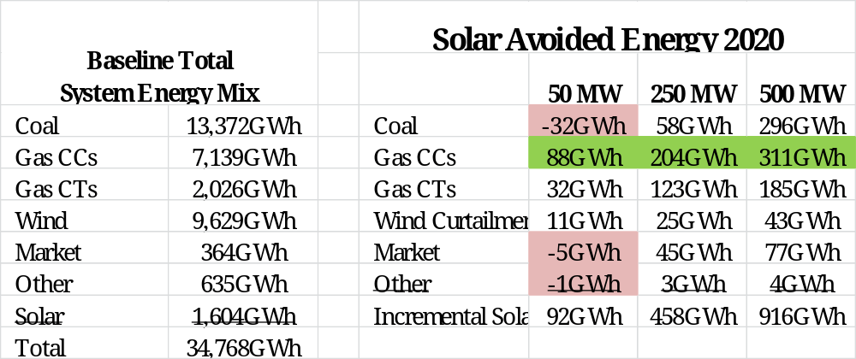
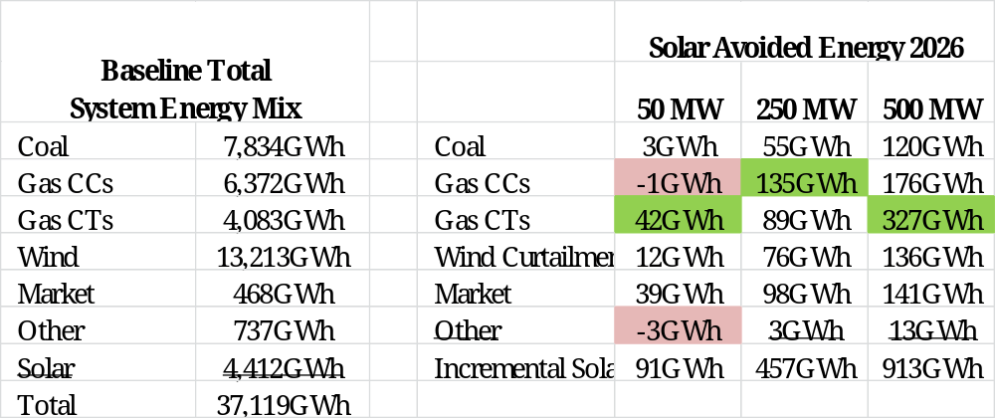
Solar Avoided Costs
- Energy Displaced by Solar Additions
Existing/Future Programs and Grid Stakeholder Group
61

Slide 62
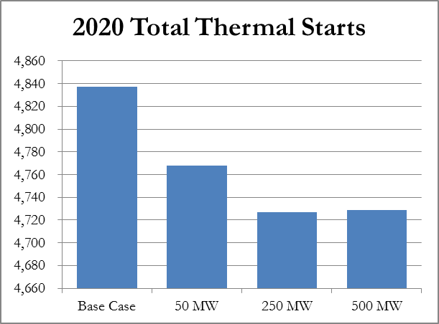
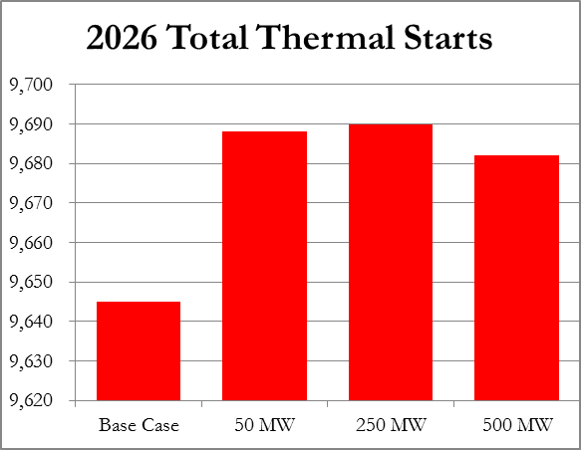
Solar Avoided Cost
- Change in Starts
Existing/Future Programs and Grid Stakeholder Group
62

Slide 63
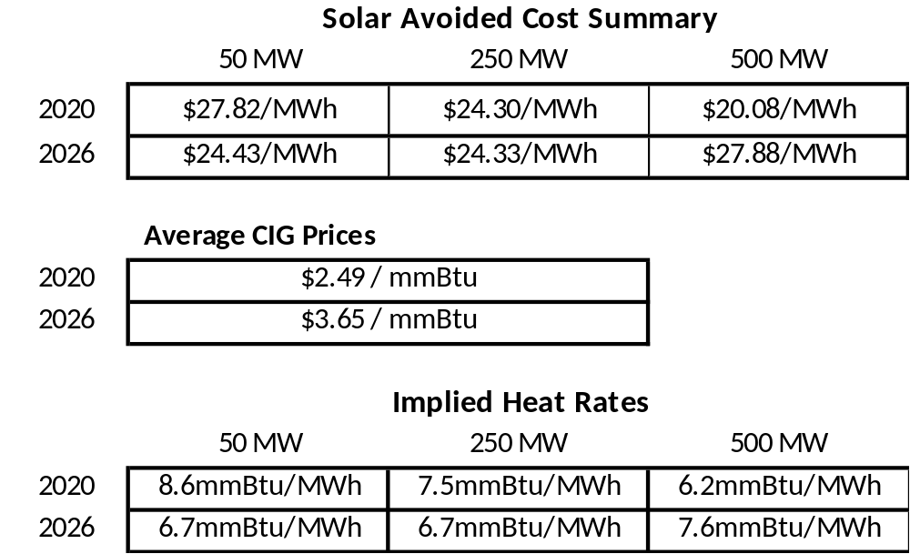
Solar Avoided Cost
Existing/Future Programs and Grid Stakeholder Group
63

Slide 64
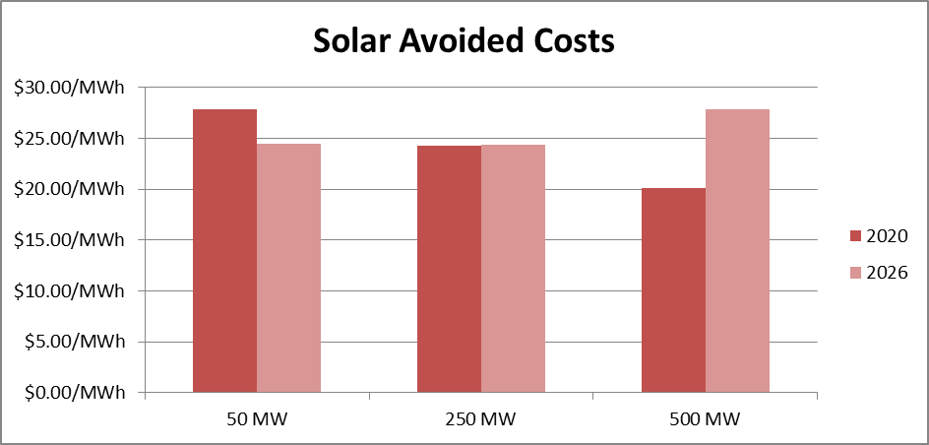
Solar Avoided Cost
Existing/Future Programs and Grid Stakeholder Group
64

Slide 65
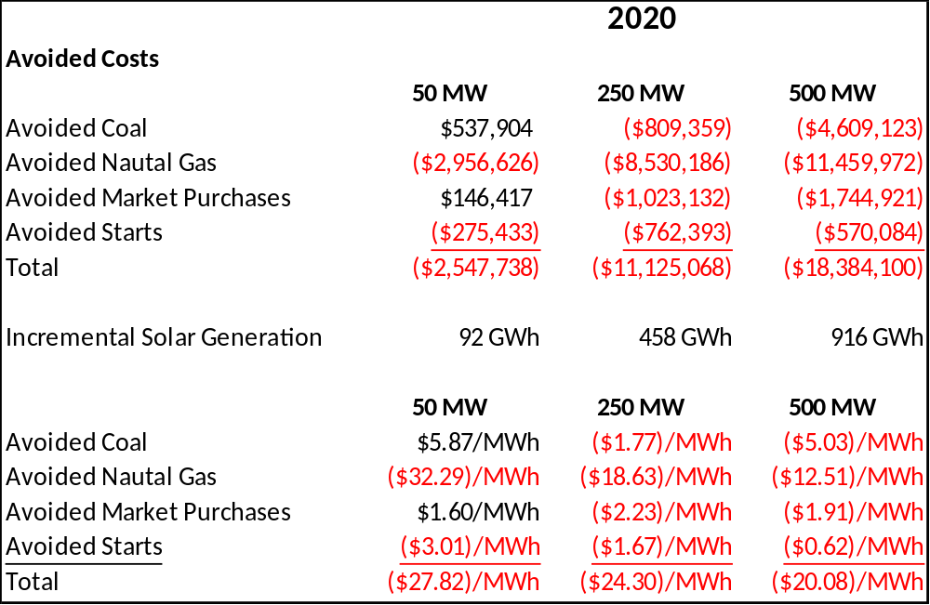
Solar Avoided Cost
Existing/Future Programs and Grid Stakeholder Group
65

Slide 66
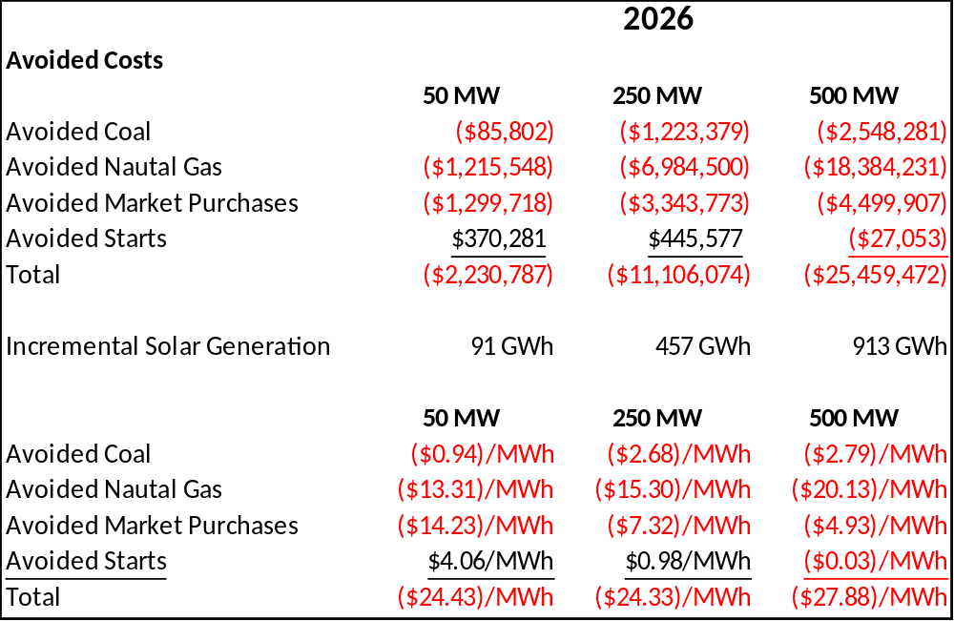
Solar Avoided Cost
Existing/Future Programs and Grid Stakeholder Group
66

Slide 67
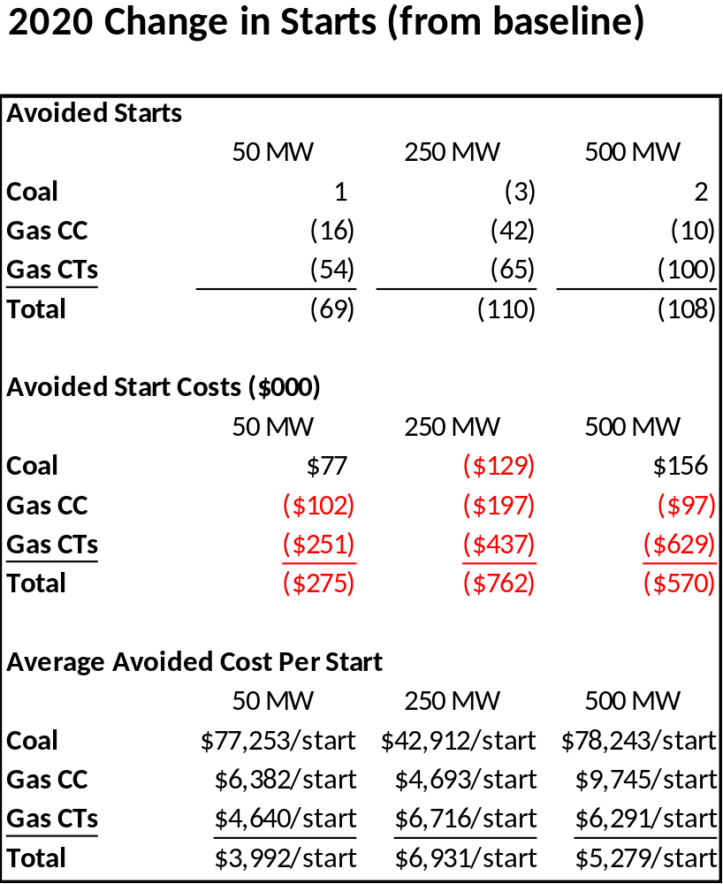
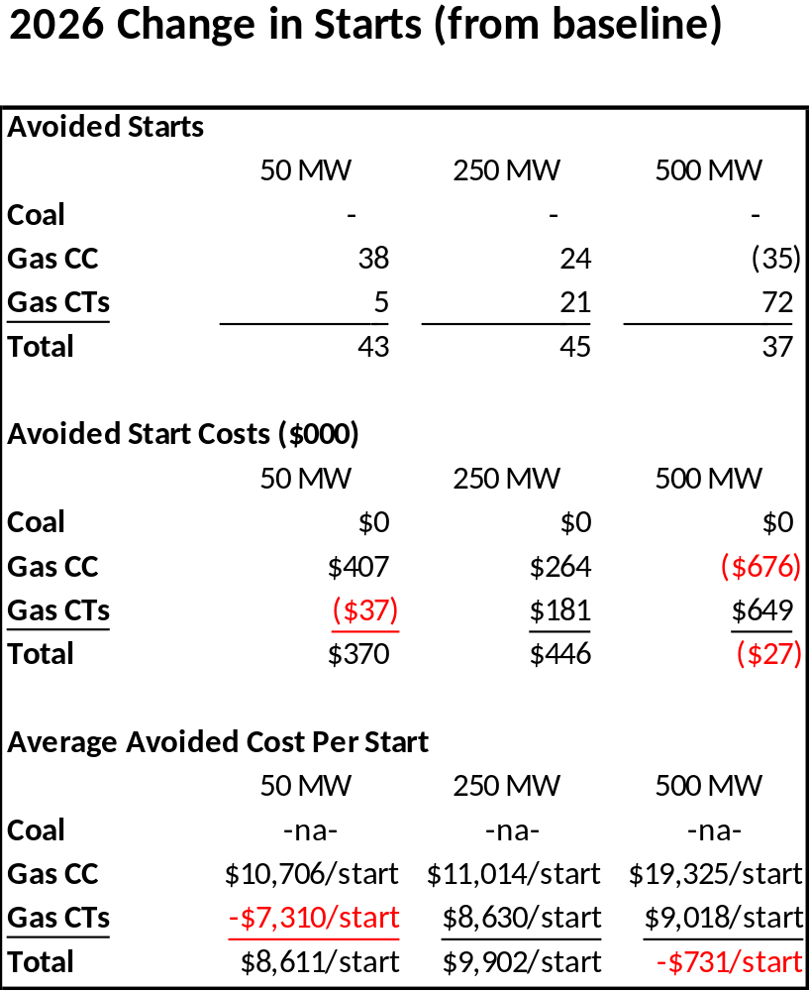
Solar Avoided Cost
Existing/Future Programs and Grid Stakeholder Group
67

Slide 68
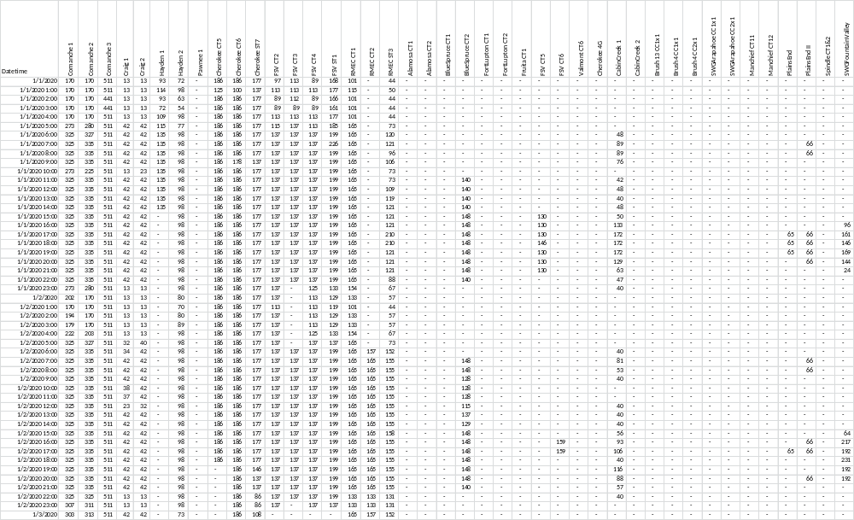
Hourly Data
Existing/Future Programs and Grid Stakeholder Group
68

Slide 69
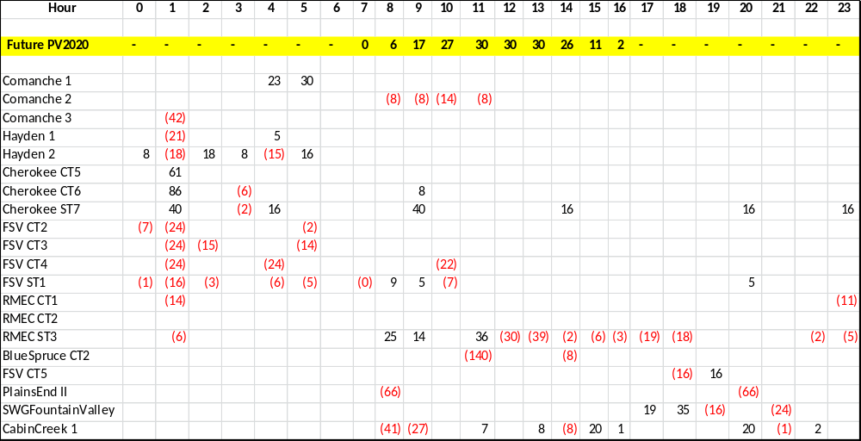
Hourly Avoided Gen
Jan 1 2020 – 50MW PV
Existing/Future Programs and Grid Stakeholder Group
69

Slide 70
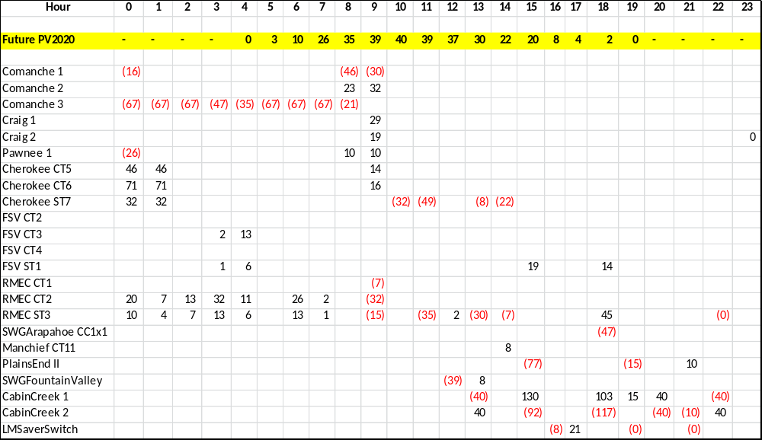
Hourly Avoided Gen
July 15th 2020 – 50MW PV
Existing/Future Programs and Grid Stakeholder Group
70

Slide 71
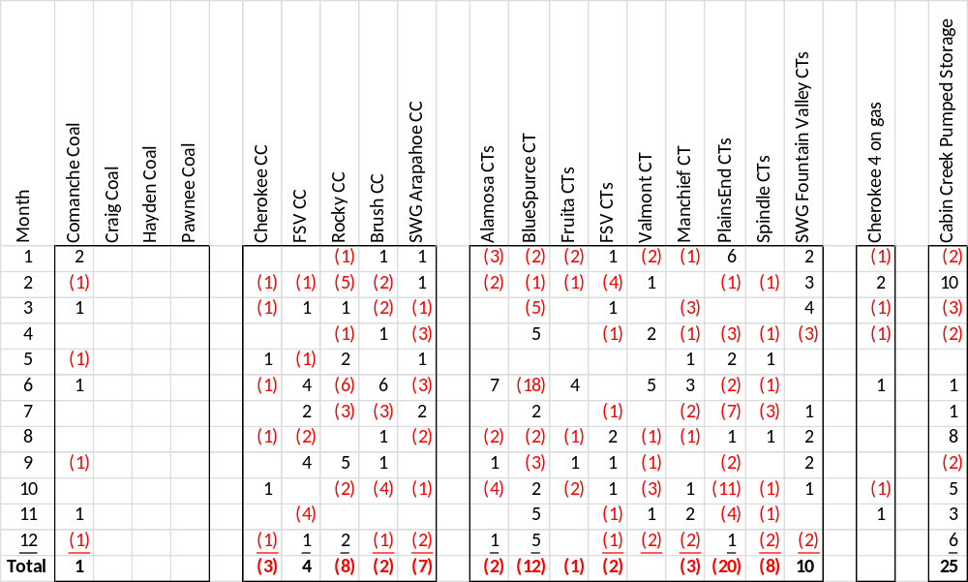
Monthly Change in Starts
2020 – 50 MW
Existing/Future Programs and Grid Stakeholder Group
71

Slide 72
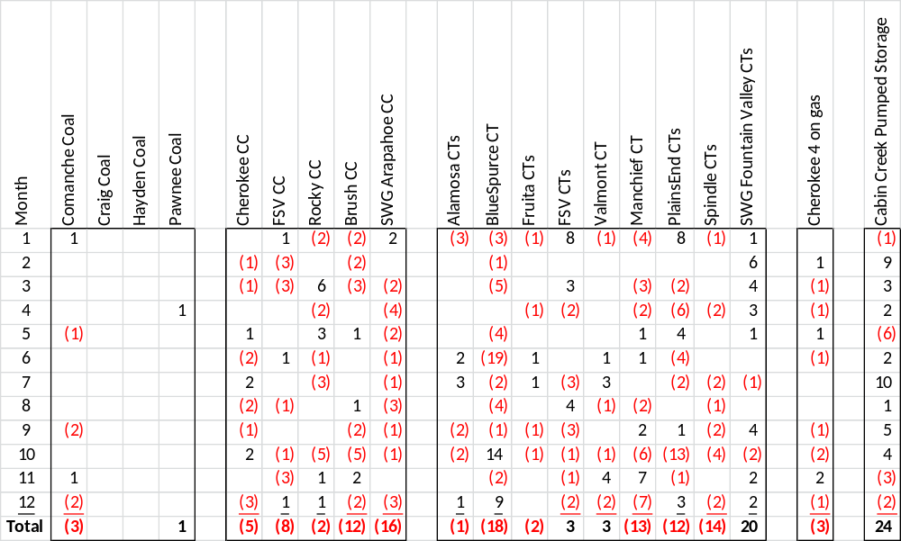
Monthly Change in Starts
2020 – 250 MW
Existing/Future Programs and Grid Stakeholder Group
72

Slide 73
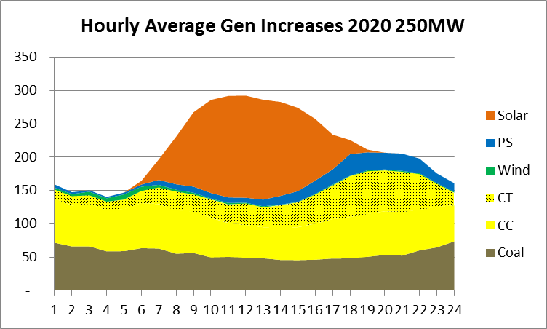
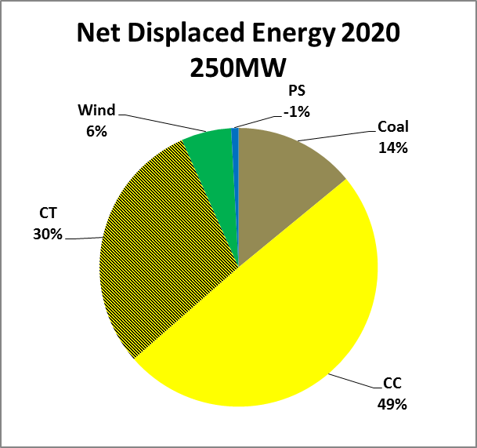
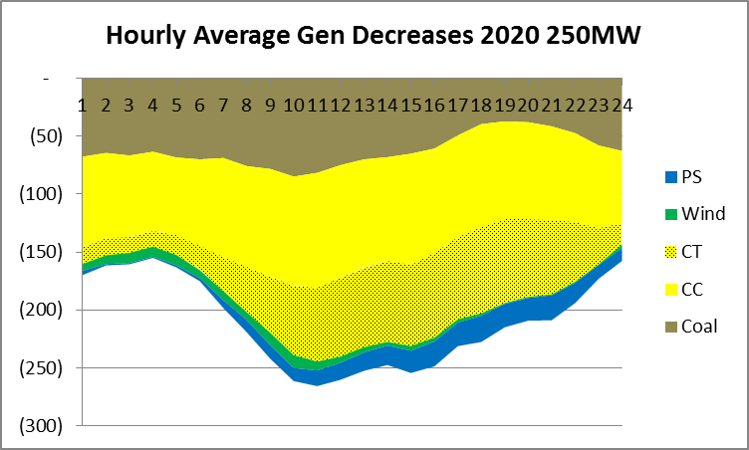
Existing/Future Programs and Grid Stakeholder Group
73

Slide 74
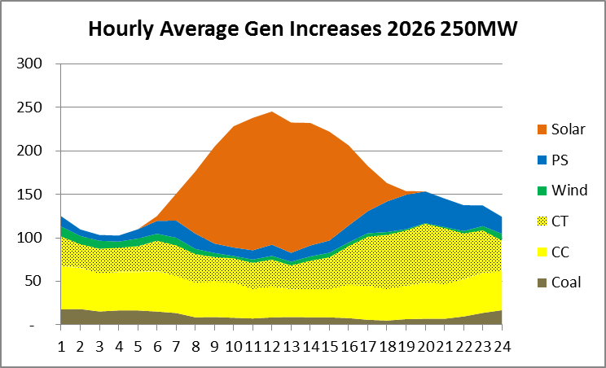
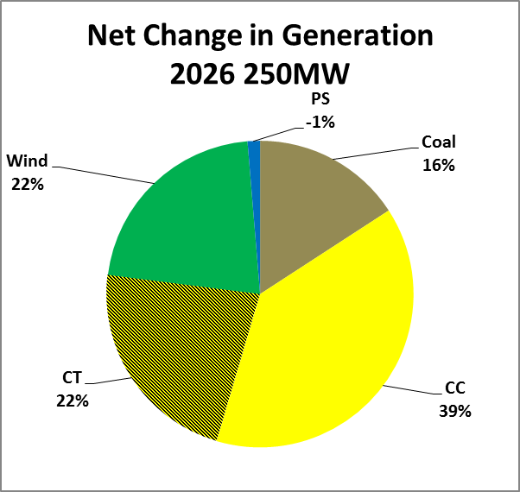
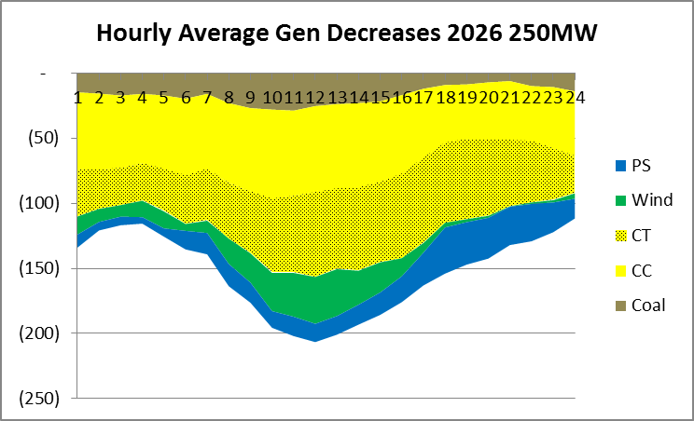
Existing/Future Programs and Grid Stakeholder Group
74

Slide 75
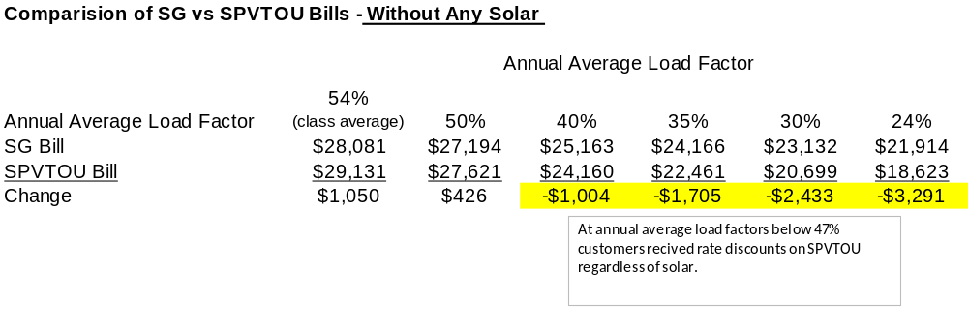
SPVTOU
Existing/Future Programs and Grid Stakeholder Group
75

Slide 76
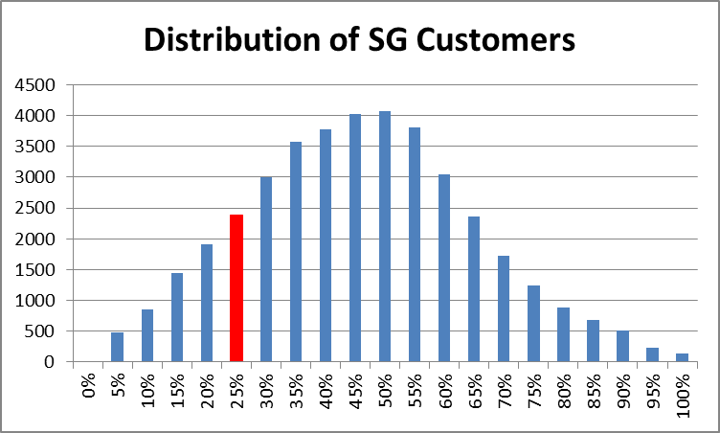
SPVTOU
Existing/Future Programs and Grid Stakeholder Group
With the 30% Load Factor Limit 82% of SG customers qualify for SPVTOU rate
Lowering to 24% would add only 6%
76

Slide 77
Wrap Up
Existing/Future Programs and Grid Stakeholder Group
Review Action Items
Future Agenda Items
Next Meeting Scheduled for May 18th
77

Slide 78


